Slide 1
JavaScript and HTML Documents
The JavaScript Execution Environment
The Document Object Model
Element Access in JavaScript
Events and Event Handling
Handling Events from Body Elements
Handling Events from Button Elements
Handling Events from Text Box and Password Elements
The DOM 2 Event Model

Slide 2
The JavaScript Execution Environment
JavaScript provides users to interact with Web Pages.
A browser displays an HTML document in a window on the screen of the client.
The JavaScript Window object represents the window that displays the document.
All JavaScript variables are properties of some object.
The properties of the Window object are visible to all JavaScript scripts that appear either implicitly or explicitly in the window’s HTML document, so they include all of the global variables.
When a global variable is created in a client-side script, it is created as a new property of the Window object.
It provides the largest enclosing referencing environment for JavaScript.

Slide 3
The JavaScript Document object represents the displayed HTML document.
Every Window object has a property named document, which is a reference to the Document object that the window displays.
The Document object is used more often than any other object in client-side JavaScript.
Every Document object has a forms array, each element of which represents a form in the document.
Each forms array element has an elements array as a property, which contains the objects that represent the HTML form elements, such as buttons and menus.

Slide 4
The highest levels of the execution environment of client-side JavaScript are represented with the Window and Document objects.
Document objects also have property arrays for anchors, links, images, and applets.
The Document object includes a forms array property, which contains references to all forms in the document.
Each element of the forms array has an elements array, which contains references to all elements in the form.

Slide 5
The Document Object Model
The Document Object Model (DOM) has been under development by the W3C since the mid-1990s.
DOM Level 3 (usually referred to as DOM 3) is the current approved version.
The original motivation for the standard DOM was to provide a specification that would allow Java programs and JavaScript scripts that deal with HTML documents to be portable among various browsers.
Although the W3C never produced such a specification, DOM 0 is the name often applied to describe the document model used by the early browsers that supported JavaScript.
Specifically, DOM 0 is the version of the document model implemented in the Netscape 3.0 and Internet Explorer 3.0 browsers.
The DOM 0 model was partially documented in the HTML 4 specification.

Slide 6
DOM 1, the first W3C DOM specification, issued in October 1998, focused on the HTML and XML document model.
DOM 2, issued in November 2000, specified a style-sheet object model and defined how style information attached to a document can be manipulated.
It also included document traversals and provided a complete and comprehensive event model.
DOM 3, issued in 2004, dealt with content models for XML (DTDs and schemas), document validation, and document views and formatting, as well as key events and event groups.
As stated previously, DOM 0 is supported by all JavaScript-enabled browsers.
DOM 2 is nearly completely supported by FX3, but IE9 leaves some parts unimplemented.
No part of DOM 3 is covered in this text.

Slide 7
The DOM is an application programming interface (API) that defines an interface between HTML documents and application programs.
It is an abstract model because it must apply to a variety of application programming languages.
Each language that interfaces with the DOM must define a binding to that interface.
The actual DOM specification consists of a collection of interfaces, including one for each document tree node type.
These interfaces are similar to Java interfaces and C++ abstract classes.
They define the objects, methods, and properties that are associated with their respective node types.
With the DOM, users can write code in programming languages to create documents, move around in their structures, and change, add, or delete elements and their content.

Slide 8
Documents in the DOM have a tree like structure, but there can be more than one tree in a document (although that is unusual).
Because the DOM is an abstract interface, it does not dictate that documents be implemented as trees or collections of trees.
Therefore, in an implementation, the relationships among the elements of a document could be represented in any number of different ways.
A language that is designed to support the DOM must have a binding to the DOM constructs.
This binding amounts to a correspondence between constructs in the language and elements in the DOM.
In the JavaScript binding to the DOM, the elements of a document are objects, with both data and operations.
The data are called properties, and the operations are, naturally, called methods.
For example, the following HTML element would be represented as an object with two properties, type and name, with the values "text" and "address", respectively:
<input type = "text" name = "address">

Slide 9
In most cases, the property names in JavaScript are the same as their corresponding attribute names in HTML.
IE8+, FX3, and C10+ provide a way of viewing the DOM structure of a displayed document.
After displaying a document with IE9, select Tools/Developer Tools.
The lower-left area of the resulting display will show an elided version of the DOM structure.
By clicking all of the eliding icons (square boxes that have plus signs in them), the whole structure will be displayed.

Slide 10
Consider the following simple document:
<!DOCTYPE html>
<!-- table2.html
A simple table to demonstrate DOM trees -->
<html lang = "en">
<head>
<title> A simple table </title>
<meta charset = "utf-8" />
</head>
<body>
<table>
<tr>
<th> </th>
<th> Apple </th>
<th> Orange </th>
</tr>
<tr>
<th> Breakfast </th>
<td> 0 </td>
<td> 1 </td>
</tr>
</table>` </body> </html>

Slide 11
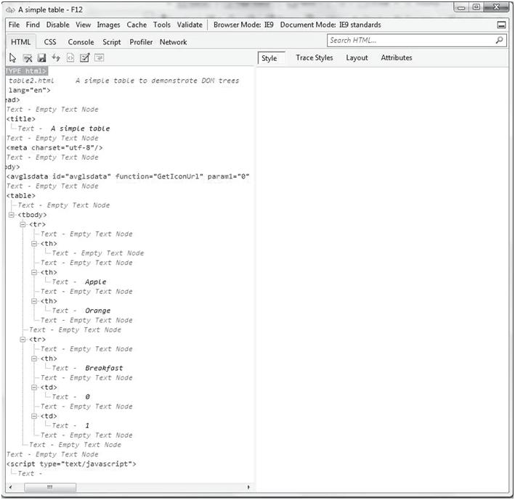

Slide 12
The IE9 Developer Tools are helpful for developing and analyzing HTML documents.
To be able to display the DOM structure of a document with FX3, an add-on must be downloaded.
The source of the download is https://addons.mozilla.org/en-US/firefox/addon/6622.
After the DOM Inspector add-on has been downloaded and installed, the DOM of a document can be displayed by selecting Tools/DOM Inspector.
If this selection is made while a document is being displayed, FX3 opens a new window that is similar to the IE9 window for DOM viewing.
As with IE9, the elements are initially elided.
The upper-right area is for displaying information about the DOM structure.

Slide 13
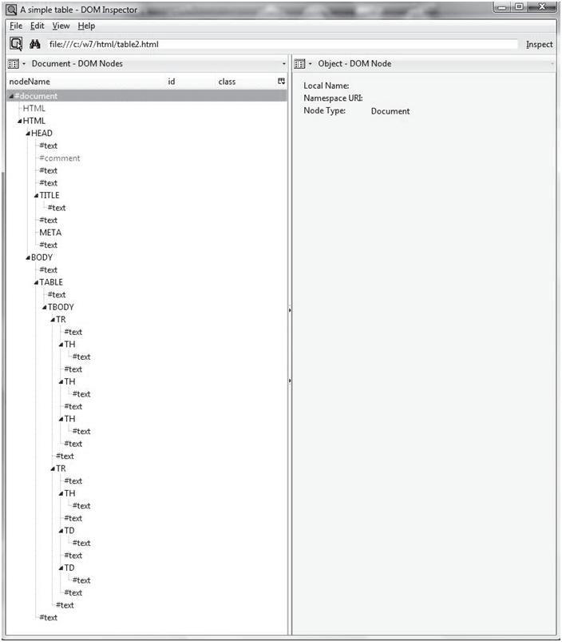
The FX3 DOM Inspector display of table2.html is shown in Figure 2.

Slide 14
With Chrome, to get the DOM one selects the extract icon, Tools, and Developer Tools.
Anything resembling a complete explanation of the DOM is far beyond the scope of this text.
Our introduction to the DOM here is intended only to provide the basis for our discussion of how JavaScript can be used to respond to document-related events and to modify element attributes, styles, and content dynamically.
A detailed description of the DOM can be found at the W3C Web site.

Slide 15
The DOM is an abstract interface whose purpose is to provide a language- independent way to access the elements of an HTML document.
Also included are the means to navigate around the structure in which the HTML elements appear.
HTML tags are represented in JavaScript as objects.
Tag attributes are represented as properties.

Slide 16
Element Access in JavaScript
The elements of an HTML document have corresponding objects that are visible to an embedded JavaScript.
The original(DOM 0) way is to use the forms and elements arrays of the Document object, which is referenced through the document property of the Window object.

Slide 17
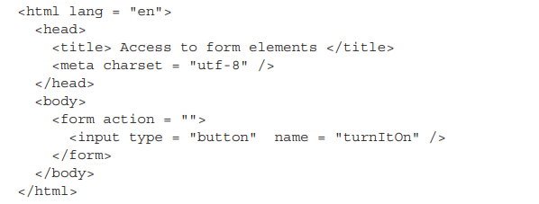
Example:

Slide 18
We refer to the address of the JavaScript object that is associated with an HTML element as the DOM address of the element.
The DOM address of the button in this example, using the forms and elements arrays, is as follows:
Another approach to DOM addressing is to use element names.
For this, the element and its enclosing elements, up to but not including the body element, must include name attributes.

Slide 19
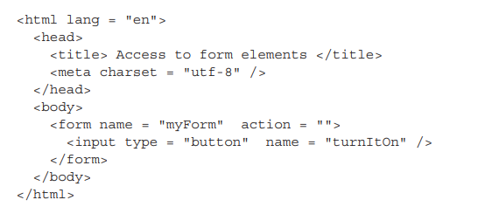
For example, consider the following document:
Using the name attributes, the button’s DOM address is as follows:
var dom = document.myForm.turnItOn;
If the id attribute of our button is set to "turnItOn", the following could be used to get the DOM address of that button element:

Slide 20
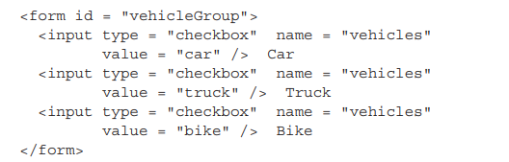
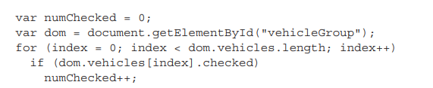
To access the arrays, the DOM address of the form object must first be obtained, as in the following example:
This array provides a convenient way to search the list of checkboxes in a group. The checked property of a checkbox object is set to true if the button is checked.
Radio buttons can be addressed and handled exactly as are the checkboxes in the foregoing code.
There are three different ways to access HTML elements in JavaScript: through the forms and elements arrays, through the names of the element and its enclosing elements, and through the getElementById method.

Slide 21
EVENT HANDLING
Basic Concepts of Event Handling:
Events are simply notifications that something specific has happened that may require some special processing.
Event-handling code provides that special processing.
There are two distinct event models currently in use.
The first is the model implemented by all browsers that support JavaScript: the DOM 0 model.
The second is the more elaborate and powerful model defined in DOM 2.
An event handler is a script that is implicitly executed in response to the appearance of an event.
Events are JavaScript objects, their names are case sensitive.
Events are created by activities associated with specific HTML elements.
The process of connecting an event handler to an event is called registration.
The write method of document should never be used in an event handler.

Slide 22
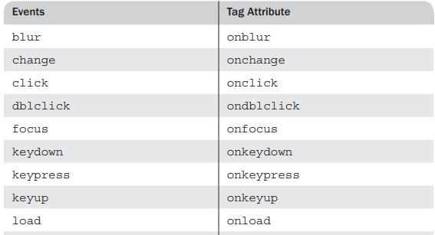
Events, Attributes and Tags:
HTML4 defined a collection of events that browsers implement and with which JavaScript can deal.
An HTML element is said to get focus when the user puts the mouse cursor over it and clicks the left mouse button.
An element becomes inexplicit when the user moves the cursor away from the element and clicks the left mouse button or when the user tabs away from the element.

Slide 23
With the DOM 0 model, each event has an associated tag attribute.
A particular attribute may appear in several different tags.
Each of these appearances is identified as a different occurrence of the same event.
The load and unload events are often used with the <body> tag to perform some operation when a document has been loaded and unloaded, respectively.
The click event is used for all of the different HTML buttons, as well as for the link of an anchor tag.
Form input can be conveniently checked by using the change event.
The submit event can also be used to check form data just before the form is submitted.

Slide 24
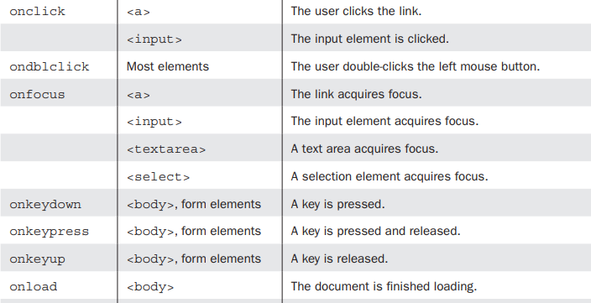

Slide 25
As mentioned previously, there are two ways to register an event handler in the DOM 0 event model.
An event handler function could also be registered by assigning its name to the associated event property on the button object,
With the DOM 0 model, there are two ways to register an event handler.
First, an attribute of the tag that defines the HTML element can be assigned the handler code.
Second, the property associated with the event of the object that represents the HTML element can be assigned the name of a function that implements the handler.
The write method of document should not be used in event handlers.

Slide 26
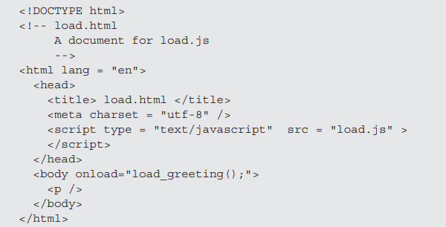
Handling Events from Body Elements:
The events most often created by body elements are load and unload.
we consider the simple case of producing an alert message when the body of the document has been loaded. In this case, we use the onload attribute of <body> to specify the event handler:

Slide 27
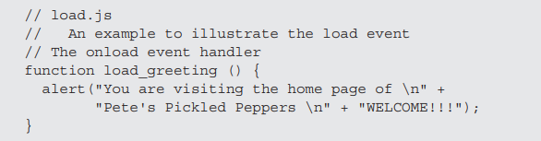

Slide 28
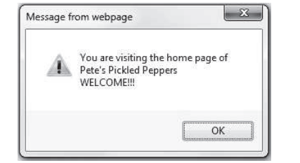
Output
The unload event is probably more useful than the load event.
It is used to do some cleanup before a document is unloaded, as when the
browser user goes on to some new document.
For example, if the document opened a second browser window, that
window could be closed by an unload event handler.

Slide 29
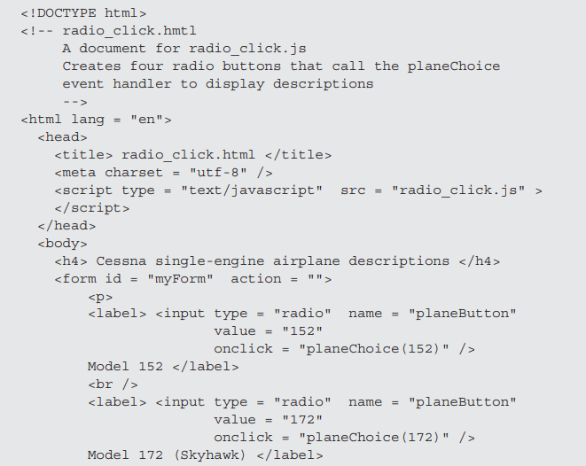
HANDLING EVENTS FROM BUTTON ELEMENTS:
Buttons in a Web document provide an effective way to collect simple input from the browser user.
The click event is used in this example to trigger a call to alert, which presents a brief description of the selected airplane.

Slide 30
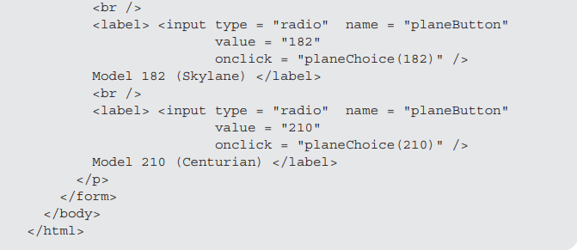
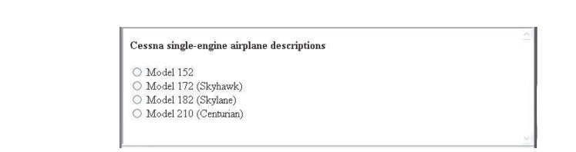
OUTPUT:

Slide 31
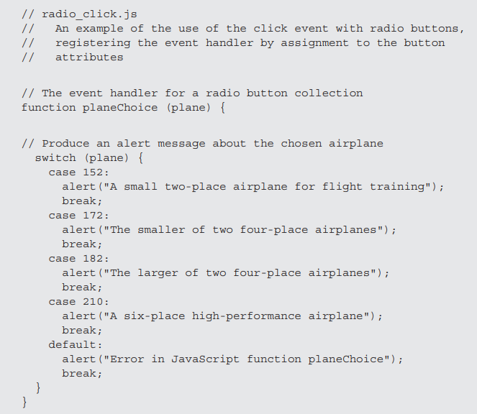
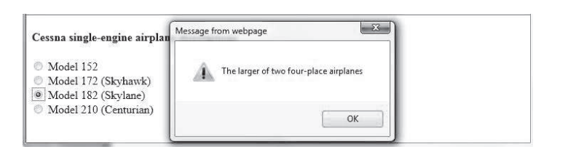
OUTPUT:

Slide 32
HANDLING EVENTS FROM TEXTBOX AND PASSWORD ELEMENTS:
1. THE FOCUS EVENT:
An unscrupulous user may be tempted to change the total cost before submission, thinking that somehow an altered (and lower) price would not be noticed at the server end.
Such a change to a text box can be prevented by an event handler that blurs the text box every time the user attempts to put it in focus.
Blur can be forced on an element with the blur method.
2. VALIDATING FORM INPUT:
The program or script on the server that processes the form data checks for invalid input data.
When invalid data is found, the server must transmit that information back to the browser, which then must ask the user to resubmit corrected input.
This approach shifts the task from the usually busy server to the client, which in most cases is only lightly used.
Even though form data is checked on the server, any errors that can be detected and corrected on the client save server and network time.

Slide 33
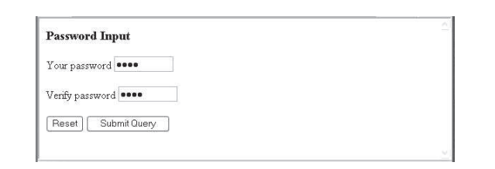
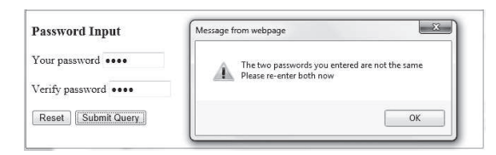
If an event handler returns false, that tells the browser not to perform any default actions of the event.
We use the convention that event handlers that check form data always return false if they detect an error and true otherwise.
The form in the next example includes the two password input elements, along with Reset and Submit buttons.
If no password has been typed into the first field, the function calls alert to produce an error message and returns false.
The second test determines whether the two typed passwords are the same.

Slide 34
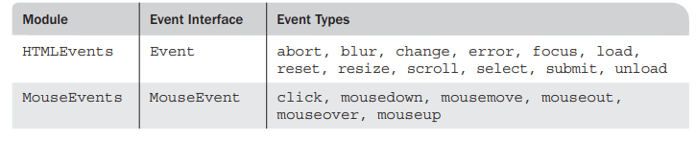
THE DOM 2 EVENT MODEL:
The DOM 2 model is a modularized interface. One of the DOM 2 modules is Events, which includes several submodules. Those most commonly used are HTMLEvents and MouseEvents.
This table shows interfaces and events defined by these modules.
1. EVENT PROPOGATION:
The connection between an event and the handler that deals with it is very simple in the DOM 0 event model.
The event handler connection for the DOM 2 event model is much more complicated.
An event object is created at some node in the document tree. For that event, that node is called the target node.
The first of these phases is called the capturing phase.

Slide 35
If there are any handlers for the event that are registered on any node encountered in this propagation, including the document node but not the target node, these handlers are checked to determine whether they are enabled.
2. EVENT HANDLER REGISTRATION:
The DOM 0 event model uses two different ways of registering event handlers.
First, the handler code can be assigned as a string literal to the event’s associated attribute in the element.
Second, the name of the handler function can be assigned to the property associated with the event.

Slide 36
The DOM 2 event model defines three phases of event processing:
capturing, target node, and bubbling.
During the capturing phase, the event object travels from the document root to the target node, where the event was created.
During the bubbling phase, the event travels back up the document tree to the root, triggering any handlers registered on nodes that are encountered.
Event handlers can be set to allow them to be triggered during the capturing phase.
Event handler registration is done with the addEventListener method, which sets whether capturing-phase triggering will take place.
Events can be unregistered with the removeEventListener method.
The currentTarget property of Event has the object through which the handler was called.
The target property has the target node object.

